Slide 1

Project 4 Group 2
Benjamin Benoit, Maxwell Jones, Savanah kennedy, will grise

Slide 2
Project overview
The Louisville Metro Police Department has recovered a desktop PC on March 2, 2016 from a suspected drug dealer, Perry Winkler a few months ago. The desktop was found in the dumpster and was slightly damaged, but the hard drive was still intact. We are tasked to find the location of Perry Winkler and any evidence Perry Winkler tried to get rid of.
Notes:
Max

Slide 3
Tools used during the analysis
The programs used for this analysis were FTK Imager, Autopsy, Arsenal Image Mounter, $I_Parse, Registry Explorer, RegRipper, LECmd, JLECmd, PECmd, Excel for parsed data, Notepad, XML Notepad, Notepad++.
Notes:
Max

Slide 4
Getting the image and verifying
Immediately after downloading the LMPD.E01 image, we imported the image into FTK Imager and verified that the hash values matched to ensure image integrity so that nothing was lost or dropped during the image download. The computed and stored hash matched.
MD5 Computed Hash – 7817995d647a2ec34b39db1e5fc35771
MD5 Stored Verification Hash - 7817995d647a2ec34b39db1e5fc35771
Notes:
Max

Slide 5
Question 1
What identifying information did you find on the hard drive to help determine the owner or user of the computer? Does the computer appear to have used by Perry Winkler?
Notes:
Max

Slide 6

Autopsy operating system information

Slide 7
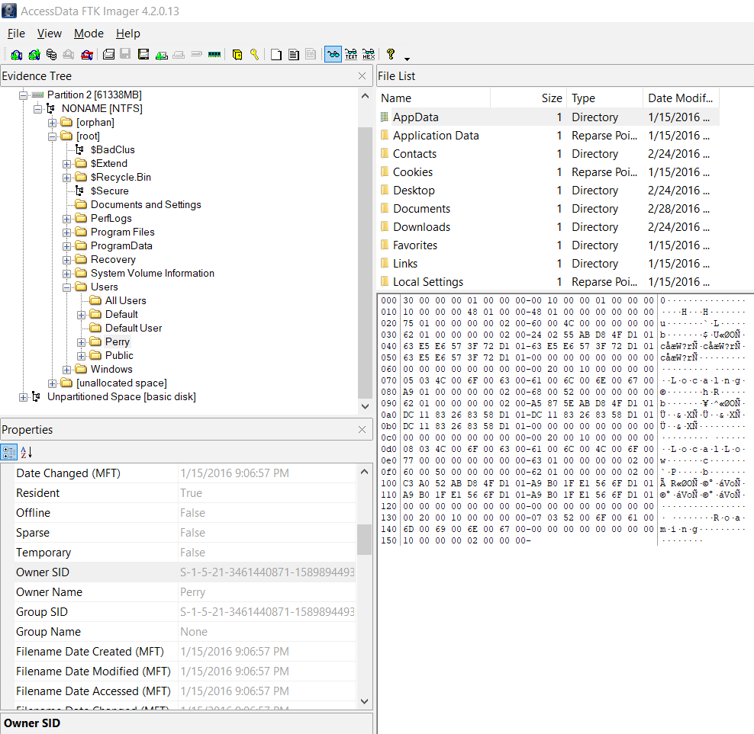
User Perry with ftk imager
Notes:
Max

Slide 8
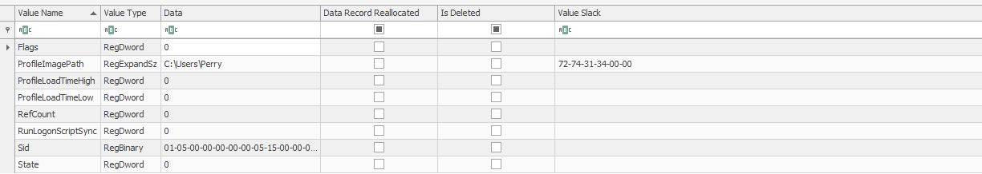
User Perry with Registry explorer
Notes:
Max

Slide 9
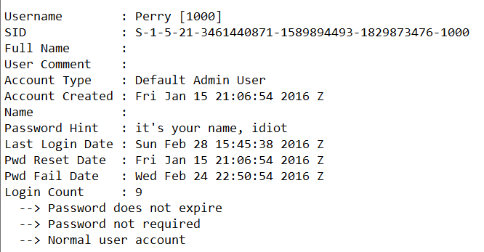
USER PERRY WITH Regripper sam hive
Notes:
Max

Slide 10
Question 2
Is there any evidence on the computer that the user may have been associated with drugs or other illegal activities?
Notes:
Savanah

Slide 11
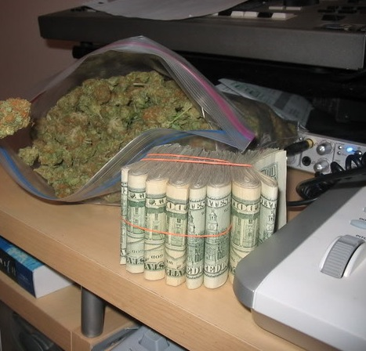
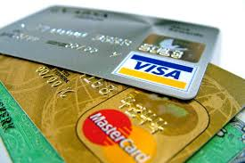
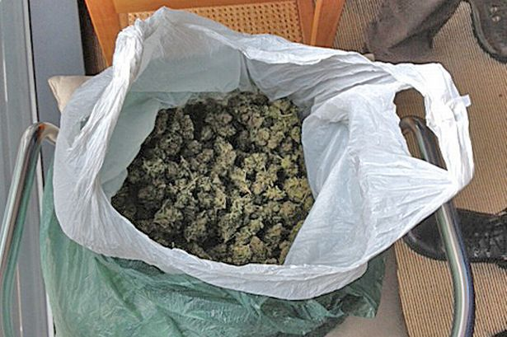
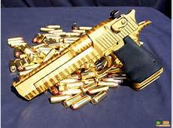
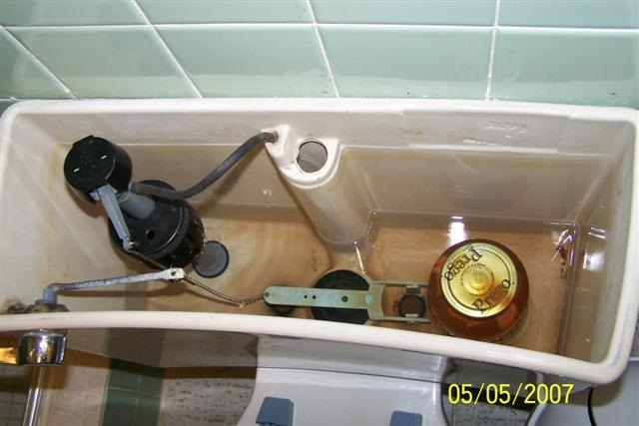
evidence on the computer that the user may have been associated with drugs or other illegal activities
Notes:
Savanah

Slide 12
Question 3
Is there any evidence that the user may have been trying to cover their tracks or delete evidence from the computer?
Notes:
Max

Slide 13
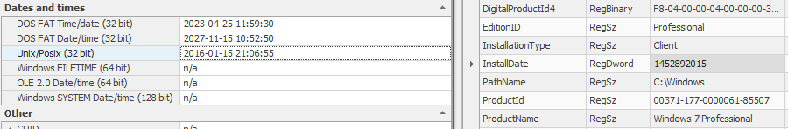
New operating system
Notes:
Max

Slide 14
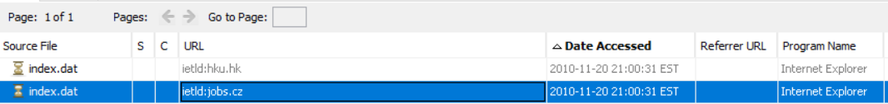
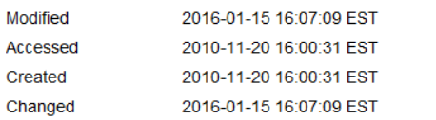
Autopsy files not matching up with os date
Notes:
Max

Slide 15
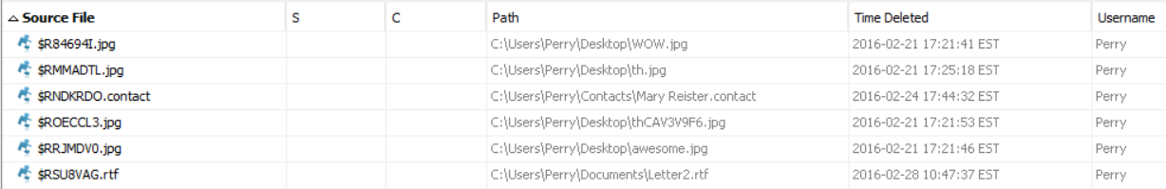
Autopsy recycling bin file carving
Notes:
Max

Slide 16
Autopsy Letter 2.rtf
Notes:
Max

Slide 17
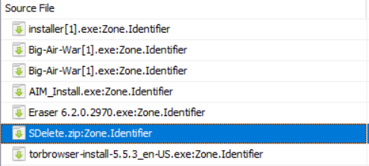
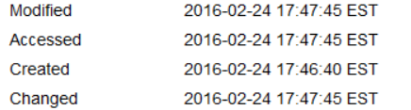
Sdelete.zip
Notes:
Max

Slide 18
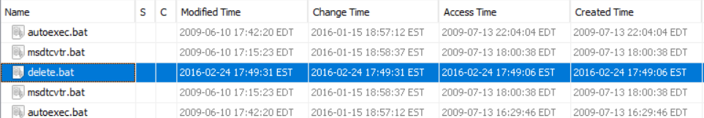
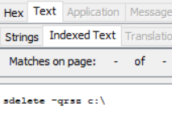
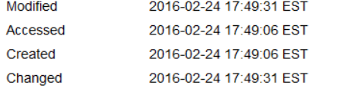
Sdelete batch file
Notes:
Max

Slide 19
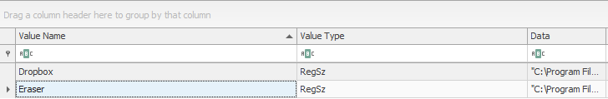
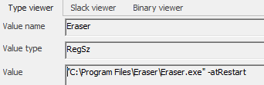
Eraser.exe registry explorer \run
Notes:
Max

Slide 20
Prefetch file looking at eraser.exe with pecmd.exe
Notes:
Max

Slide 21
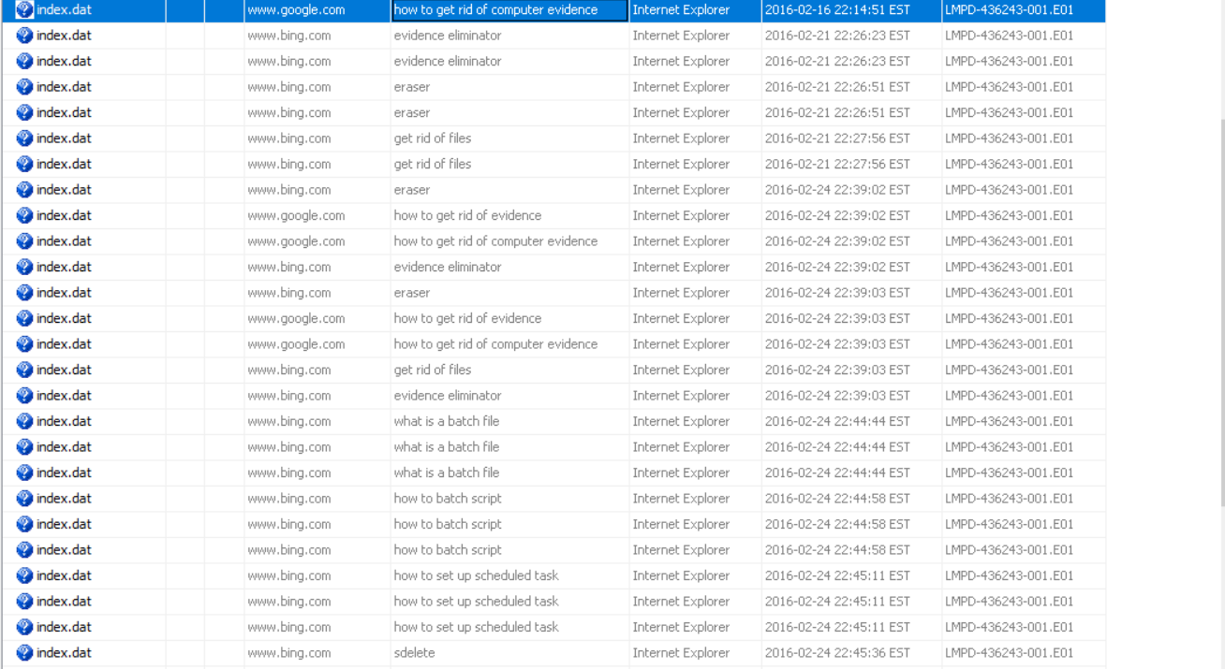
Autopsy \results\Extracted\web search
Notes:
Max

Slide 22
Question 4
Can you identify any additional items (such as USB devices) that may contain pertinent evidence? If so, what are they? Include as much identifying information about each device as possible.
Notes:
Will

Slide 23
REMOVABLE devices
THERE ARE TWO USB DEVICES ACCORDING TO USBSTOR IN THE SYSTEM HIVE.
THE TWO DEVICES ARE A KINGSTON DT 101 G2 USB AND A SANDISK CRUZER USB
BOTH DEVICES ARE USED TO STORE IMAGES
THE KINGSTON USB WITH VOLUME SERIAL NUMBER IS 3AA4C98B AND IT CONTAINS THE CAR1.JPG AND THE CAR2.JPG
THESE IMAGES SHOW PHOTOS OF VEHICLES WHICH MAY HAVE BEEN USED FOR CRIMINAL ACTIVITY
THE SANDISK DRIVE HAS A VOLUME SERIAL NUMBER OF A0C9328E AND IT CONTAINS THE IMAGE mike's desk.jpg
THE mike's desk.jpg SHOWS THE DESK OF A POTENTIAL ACCOMPLICE OF MR. WINKLER WITH A LARGE BAG OF DRUGS, A ROLL OF CASH AND A COMPUTER
THESE USBS NEED TO BE FOUND AS THEY CONTAIN POTENTIAL EVIDENCE WHICH COULD PROVE USEFUL TO THE CASE
Notes:
Will

Slide 24
Question 5
Is there any evidence on the computer that the user may have been planning to go on the run? If so, can you determine where the user was planning to go? a. If the user was planning to run, is there evidence that anyone might be traveling with them? If so, can you determine the identity of the accomplice(s)?
Notes:
Savanah

Slide 25
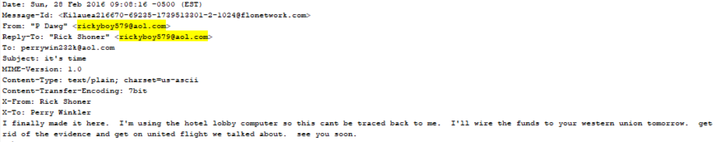

Autopsy email investigation
Notes:
Savanah

Slide 26
Question 6
What other evidence did you locate on the computer that may assist LMPD in its investigation (e.g. files that point to additional leads, accomplices, or any other activity not targeted by the initial investigation)?
Notes:
Ben

Slide 27
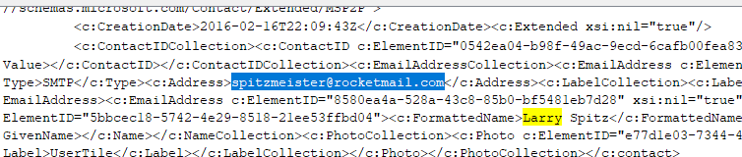
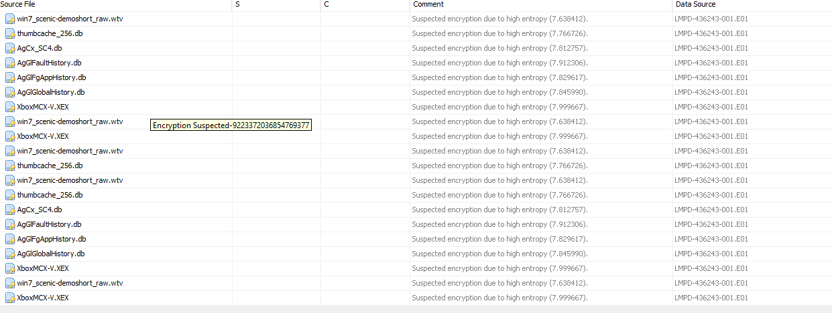
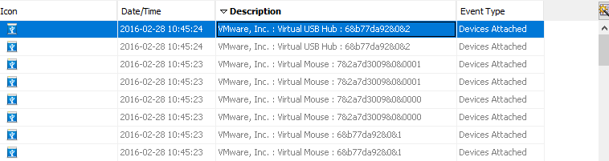
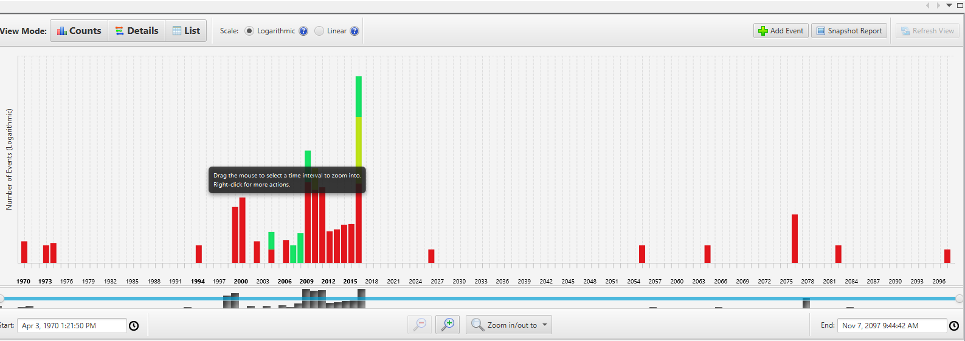
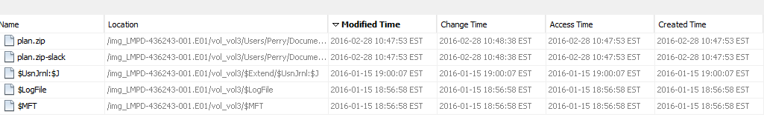
Question 6
Notes:
Ben

Slide 28
Questions?

Slide 29

Thank You!

